Slide 1
One Codebase: Windows, Web, Mobile
Using .NET MAUI Blazor & Blazor

Slide 2

About Your Speaker
Mitch Sellers
Microsoft MVP, ASPInsider, etc
CEO @ IowaComputerGurus, Inc.
Contact Info
msellers@iowacomputergurus.com
@mitchelsellers
www.mitchelsellers.com

Slide 3

Agenda
The Development Scenario
Overview of Tools Available
Introducing .NET MAUI Blazor
Special Considerations
Application Options/Considerations
DevOps Considerations
Costs/Planning

Slide 4

The Development Scenario
Mobile, Desktop, and Web are Desired
Creation of a Web interface that requires MINIMAL extra effort to manage/manipulate
Creation of an easy process to build/test/package the entire solution at once
Responsive Mobile does not provide enough options
API’s and backend logic are not included in today’s discussion

Slide 5

Tools Available Today
Xamarin (Xamarin.Forms)
Legacy iOS/Android (Uses XAML)
.NET MAUI
XAML Based
Windows, Mac, iOS, Android, Tizen
UNO Platform
C# XAML Based
Windows, Mac, iOS, Androiz, Tizen, WASM, and Linux

Slide 6
Introducing .NET MAUI Blazor
Think of it as a web app that runs on mobile
Fully supports multiple targets, including access to device specific hardware (camera, nfc, etc)
Apple
Android
Windows
Mac
Design/Develop/Build like it is web
Introduces some minimum versions that should be understood

Slide 7
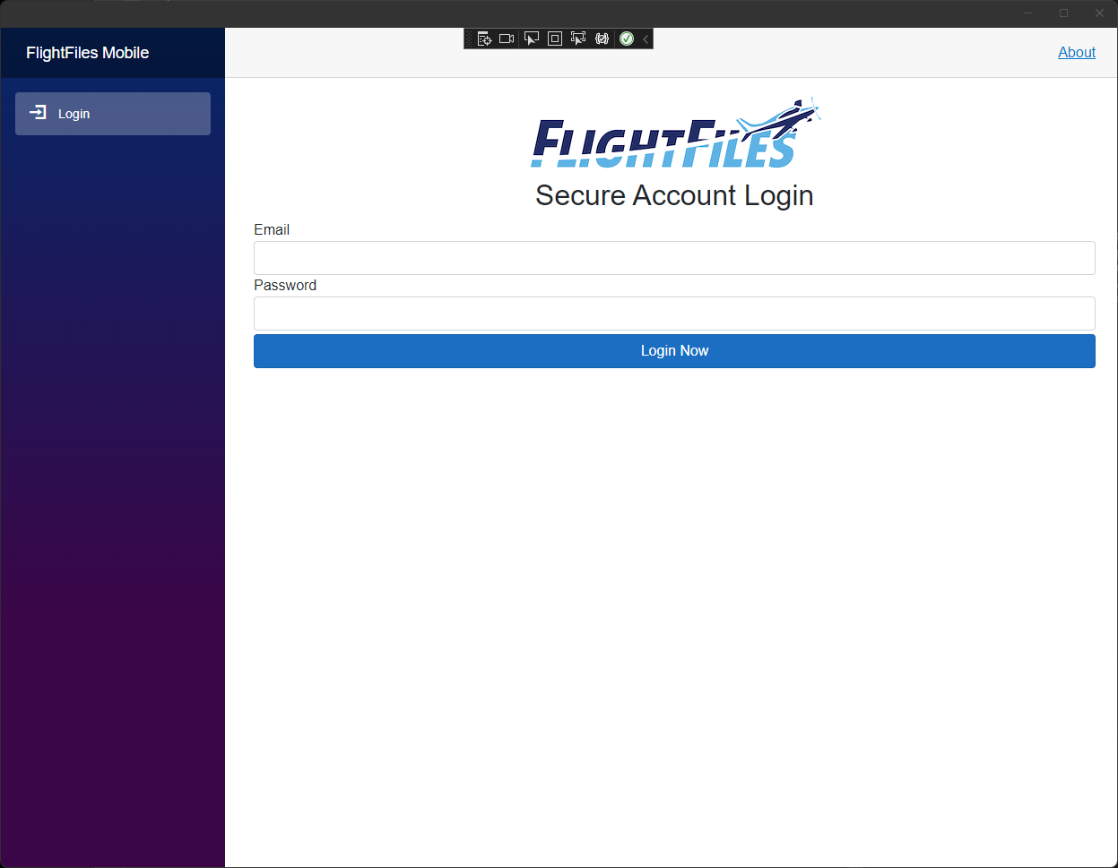
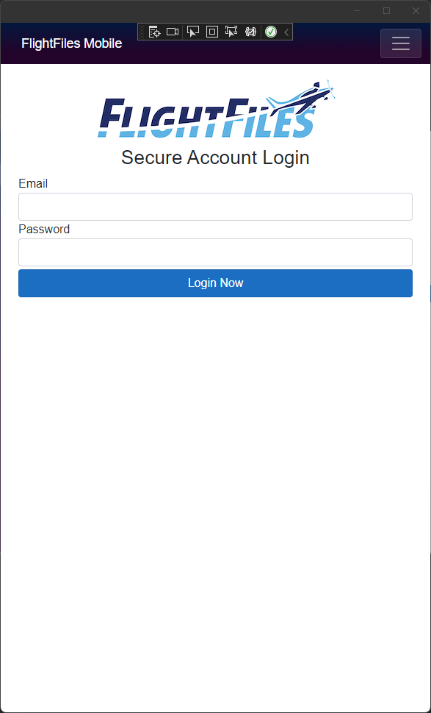
Example

Slide 8
.NET MAUI Blazor Minimum Target Versions
Requires Microsoft Edge WebView2
Minimums
Android 7.0 (API 24) – Should be a non-issue
iOS 14+ - This could be a concern
macOS 11 or higher, using Mac Catalyst

Slide 9

Some Additional .NET MAUI Blazor Tips
No concern with publishing to the App Stores, but verbiage is key in submission.
On Windows you are running a web-app, this introduces a bit of a limitation with recent Windows 11 Releases
Developer Support/Advancement is Swift, Update regularly

Slide 10

How About Web?
Some individuals are looking for a truly “consistent” experience across all device types, this can be achieved with a slight re-architecture of the existing solution.
Business Use Cases
Ease of deployment, but multi-targeted
Flexibility, but singular training
Pitfalls from Production Usage
Platform Specific Changes are hard
Is it really the “Right” user experience

Slide 11
Making It Happen
.NET MAUI Blazor
ASP.NET Core Blazor
Razor Class Library

Slide 12
Where Code Lives
High-Level Components – Components Project
View Models
Views
Routing/Page setup – Individual UI Projects
Future VS 2022 Updates will include a new project template

Slide 13

Let’s Get Started!

